Slide 1


Capstone Project
Yvesna MARCELIN
yvesnamarcelin48@gmail.com
Ayiti Analyctics

Slide 2

Predicting Categories Domains of Job
Machine Learning approch (NLP)
Thursday, September 30th 2021

Slide 3

Agenda
Summary
01
Introduction
Define the subject
Context
02
Methodology
Data source
Relevant Analysis
03
Model
Machine Learning
04
Conclusions
Limits
Other Perspective

Slide 4
Introduction
Define the subject and Context
To keep up with the needs and requirements of the job market, our young academics and professionals are looking for information and advices. Because it's become more and more difficult to access the job market.
In addition to the evolution of technology and the different problems that young people are facing, the processes of offers and recruitments are constantly evolving.
In Haiti very often after their classical studies the young people have difficulty to orient themselves towards a domain of study.
Being in the domain of technology, I thought it was important to help them understand the domain in which they could be interested.

Slide 5





Methodology
Naturel Language Processing
Using NLP to analyze and process our text data from human language
Data Cleaning
Using NumPy and Pandas to start data cleaning
Model
Using Classification model in Machine Learning.
Data Source
The data used are collected from Jobpaw
Conclusion
Summarize the project and present new perspective

Slide 6
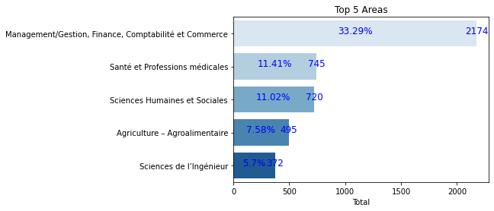
Results
The domains of study most in demand
69%
The percentage of the most requested domains is 69%.

Slide 7
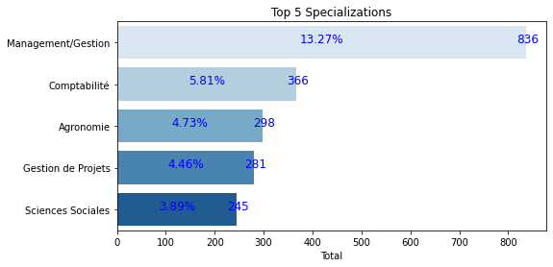

Results
The Specializations most in demand
51%
These specializations represent 51% of the most requested

Slide 8
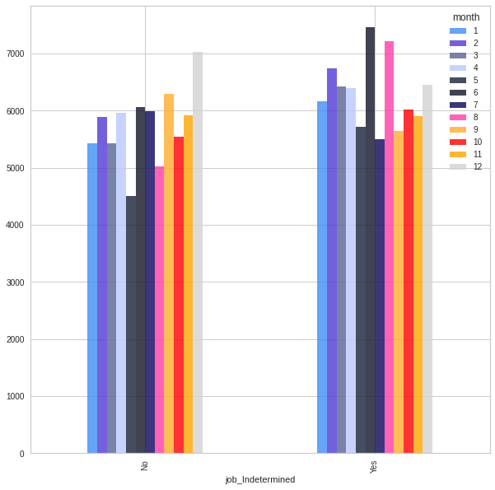

Results
Indeterminate job per month
Here we made a ranking for the jobs determined over a period of time and those not determined. We have done a chi-square test to see if there is a significant difference. The month of December gives a lot more determined time jobs and in June the non determined ones.

Slide 9
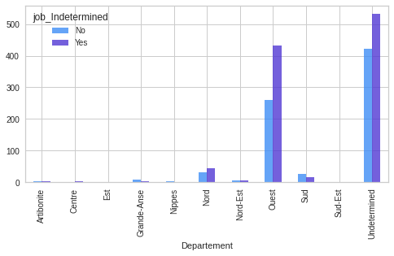

Results
Indeterminate Job per department
This is a ranking by department. we have a significant difference. The western department offers more full time work. The other department is not mentioned.

Slide 10

Results
If we try to interpret the results of the two previous graphs, we can say that the months that offer more full-time and part-time work are June and August. But at the end of the year, in December, the jobs are determined. The months of June and August are to be taken into account when a full-time or part-time contract is to be concluded.
For the departments, the Western department gives not only the determined and not determined jobs, besides the Western department, the Northern department gives the same options.

Slide 11
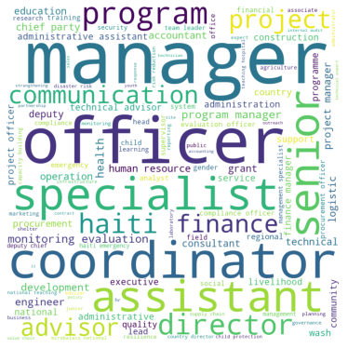
The most recurrent job title terms
The job titles do not allow any adequate classification. Some are same but different in their description. So we made a Worl Cloud in order to see the most repeated titles.

Slide 12
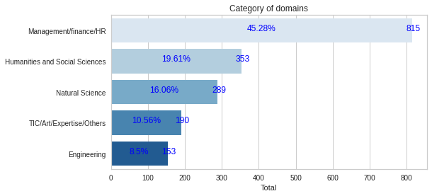

Classification of categories of domains
By classifying the domains, Management remains the most requested domain, followed by Human and Social Sciences, for example Education Science.

Slide 13

Model
We use machine learning to find a model that can predict domains categories.
We have chosen four models to find the most appropriate.
The metrics we will take account to find the most appropriate are: The score and the learning speed, means the time. If the model has the highest score and takes much less time to run, it is considered the most appropriate model.
Some machine learning models
Names | Scores | Times
Logistic Regression | 0.731481 | 17.898961
Ridge Classifier | 0.781481 | 2.123926
RandomForestClassifier | 0.672222 | 4.995218
KNeighborsClassifier | 0.672222 | 4.221043

Slide 14
Ridge Classifier model
We build our model with the classification we made with the domains of study.
The model we have chosen here is the Ridge Classifier witch has a good Accuracy, of 78%. And good score for each category.
0.88
Engineering
Ridge Classifier
Scores
0.83
Management/
Finance/HR
0.77
Naturel Science
0.71
Humanities/Social
Sciences
0.57
TIC/Art/Expertise/Others

Slide 15
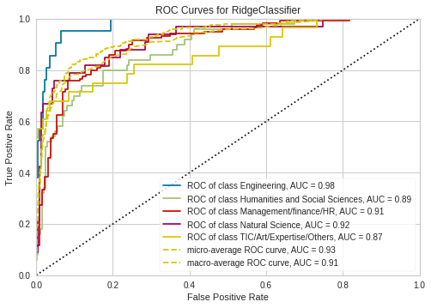
Classification ROC Curve and AUC
Here we have a ROC Curve (Receiver Operating Characteristic Curve). It is a graph showing the performance of our classification model by visualization. AUC (Area under the ROC Curve) provides an aggregate measure of performance across all our possible classification.

Slide 16
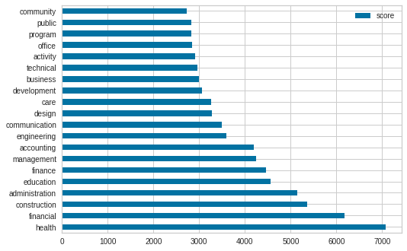
Results
Here we have a graph showing the top 20 of the preeminent words that can classify a domain in our model. Like if we passed the words office to the machine, it can predict if it belongs to the domain of Management/ Finance/HR, Natural Science or Humanities and Socials Sciences.
Preeminent words

Slide 17
Conclusion
In short, the goal of this project was to categorize the various domains and then develop a machine learning model to predict which domain category the machine will predict using a word passed as a command.
It should be noted that the work here is drawn exclusively from webscrapper data on jobpaw. Therefore, we have job titles, domains, specialties and other variables in English but also in French. With the Natural Language Processing, we have operated the main tasks to eliminate the non-desired characters, url etc. Then normalize our data: Tokenization, Stemming and Lemmatization. To then make our machine learning model. Our model is thus realized with the data in English.
As a new perspective we can try to do a more advanced work with the NLP as an automatic translation in order to normalize all our data at once and make a Deep Learning model with a better score.

Slide 18

References:
Link GitHub for the Project: https://github.com/Yvesie67/Capstone_Project#capstone_project
For more question:
yvesnamarcelin48@gmail.com

